Slide 1
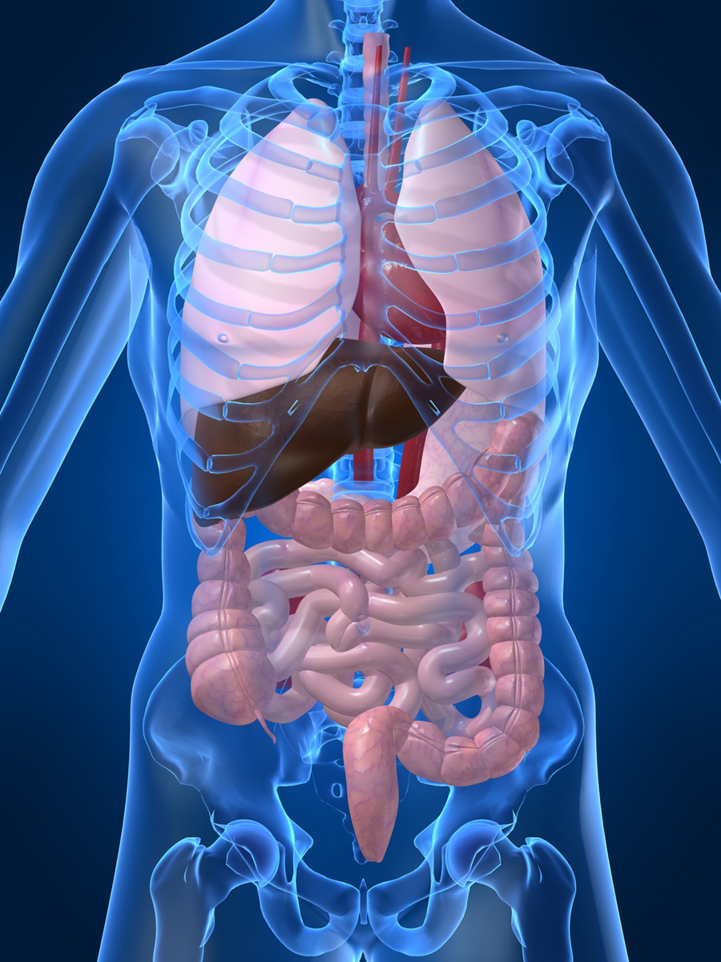
Organ Systems

Slide 2
SC.6.L.14.5 Bellringer
1. Which two systems in the human body work together to eliminate carbon dioxide (CO₂) from the body?
a. The excretory and digestive systems
b. The digestive and circulatory systems
c. The excretory and respiratory systems
d. The respiratory and circulatory systems
2. Body systems interact with each other to maintain homeostasis. Which of the following is an example of interdependent body systems working together to maintain homeostasis?
a. The nervous system senses a loud unexpected noise, and the circulatory system increases the heart rate.
b. The musculoskeletal system gets infected through a cut, and the vascular system responds with inflammation.
c. The digestive system produces wastes, and the respiratory system eliminates waste in the form of carbon dioxide.
d. The respiratory system increases the intake of oxygen during exercise, and the circulatory system distributes the oxygen throughout the body.

Slide 3
Organ Systems a Review!!!
http://sciencenetlinks.com/interactives/systems.html
Did you recognize the different components of the organ systems?
How do they work together to maintain homeostasis?

Slide 4
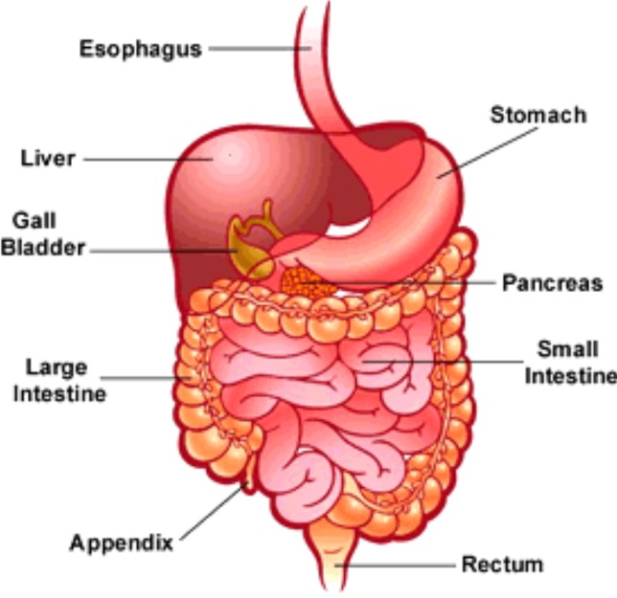
The Digestive System

Slide 5
The Digestive System
The primary function of the digestive system is to break down the food we eat into smaller parts so the body can use them to build and nourish cells and provide energy.
http://www.brainpop.com/health/bodysystems/digestivesystem/

Slide 6
The Respiratory System

Slide 7
The Respiratory System
The respiratory system consists of the nasal cavity, the mouth, larynx, pharynx, trachea, bronchial tubes, lungs, and diaphragm. These parts are well protected by the facial bones, ribs, and tough cartilage. The respiratory system works very closely with all the other organ systems, particularly the circulatory system.
The job of your respiratory system is very simple: To bring oxygen into your body, and remove the carbon dioxide from your body. Your body needs oxygen to survive.
http://www.brainpop.com/health/bodysystems/respiratorysystem/

Slide 8
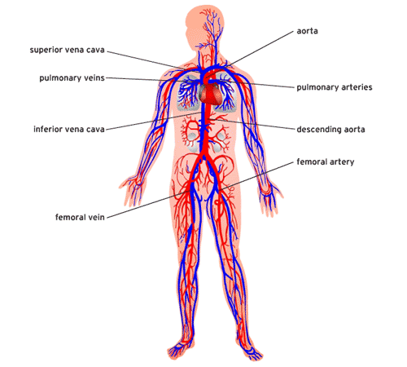
The Circulatory System

Slide 9
The Circulatory System
The circulatory system takes food and air from outside your body and brings it all over your body so that all your cells get the food and oxygen they need to stay alive.
http://www.brainpop.com/health/bodysystems/circulatorysystem/

Slide 10
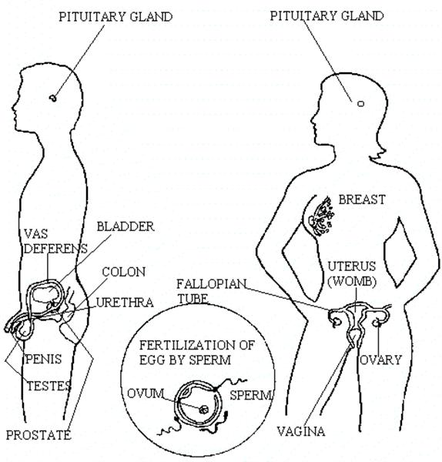
The Reproductive System

Slide 11
The Reproductive System
There are mainly four functions of our reproductive system: To produce egg and sperm cells, to transport and sustain these cells, to nurture the developing offspring and to produce hormones.
http://player.discoveryeducation.com/index.cfm?guidAssetId=BBF8184E-D618-48E0-95A4-8B711C08C09C

Slide 12
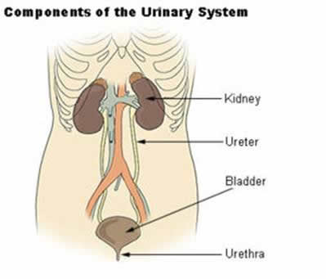
The Excretory System

Slide 13
The Excretory System
The primary functions of the excretory system are to
Get rid of wastes
Eliminates useless by-products excreted from cells.
Eradicates harmful chemical build-ups.
Maintains a steady, balanced chemical concentration.
http://burton.k12.ca.us/JMA/excretory_system.htm

Slide 14
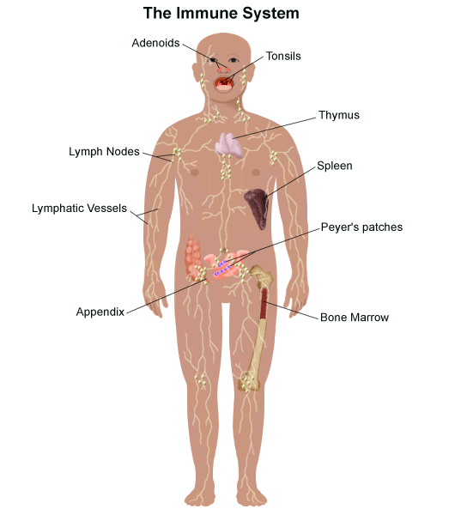
The Immune System

Slide 15
The Immune System
The immune system, which is made up of special cells, proteins, tissues, and organs, defends people against germs and microorganisms every day. In most cases, the immune system does a great job of keeping people healthy and preventing infections. But sometimes problems with the immune system can lead to illness and infection.
http://www.brainpop.com/health/bodysystems/immunesystem/

Slide 16
The Nervous System

Slide 17
The Nervous System
Your nervous system receives information about what is happening both inside and outside your body. It also directs the way in which your body responds to this information. In addition, the nervous system helps maintain homeostasis. A stimulus is any change or signal in the environment that can make an organism react.
Your nervous system consists of the central and peripheral systems. The central nervous system (CNS), includes the brain and spinal cord; the peripheral system includes the nerves to the rest of the body.
http://kidshealth.org/kid/htbw/brain.html

Slide 18
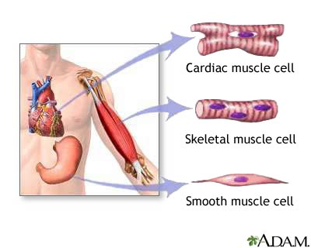
Musculoskeletal (Muscular/Skeletal) System
BrainPop Video!
There are three types of muscles:
Skeletal (Voluntary),
Smooth (Involuntary),
Cardiac (Involuntary).
Functions:
Control movement.

Slide 19
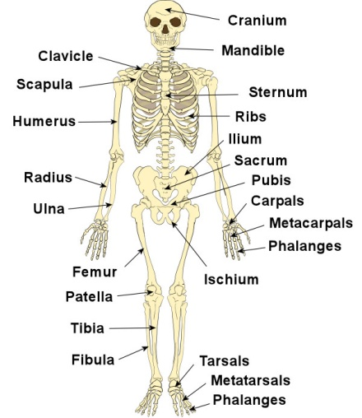
Skeletal System
BrainPop Video!
Structures:
Composed of :
bones,
cartilage,
ligaments, and
tendons.
Functions:
provides movement,
protection,
shape,
support
produces red blood cells.

Slide 20
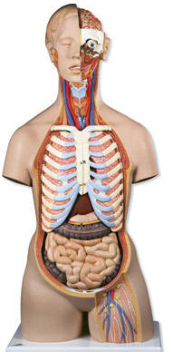
Left Side
Label at least five body systems on the image of the torso.
For each system you could not label, describe how each interacts with another body system.

Slide 21
Exit Ticket
1. Living things have body systems that are interrelated. That means they work together to carry out bodily functions. Which human body systems function together to distribute oxygen for use in cellular processes throughout the body?
2. Homeostasis describes the stable environment that the human body maintains, enabling the body to function properly. When an outside stimulus threatens to disrupt homeostasis, body systems work to bring things back into balance. Explain how systems of the body work together to maintain homeostasis.

